Slide 1
Sustainability as an Opportunity for social housing
Vienna/18.6.2024
Using the energy transition to reduce costs for homeless service providers

Slide 2
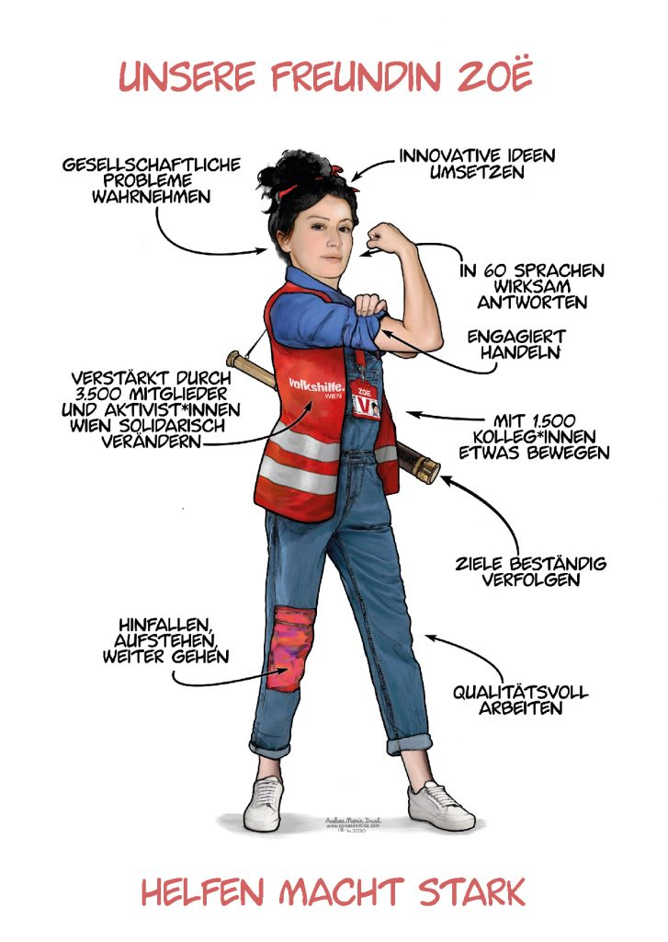
Volkshilfe wien
Member of „Volkshilfe Austria“ – one of the biggest social organisations in Austria
almost 1800 employees in Vienna
fields of activities:
services for homeless people – stationary facilities, housing first, …
housing for refugees and displaced persons
accomodations for kids and youths
eviction prevention
information center for sexworkers
mobile care
labour market projects

Slide 3
Stationary facilities
Five stationary facilities in Vienna:
3 for refugees, 2 for homeless people, 1 for women in difficult situations
all are rented
different conservations status – from „bad“ to „new“

Slide 4
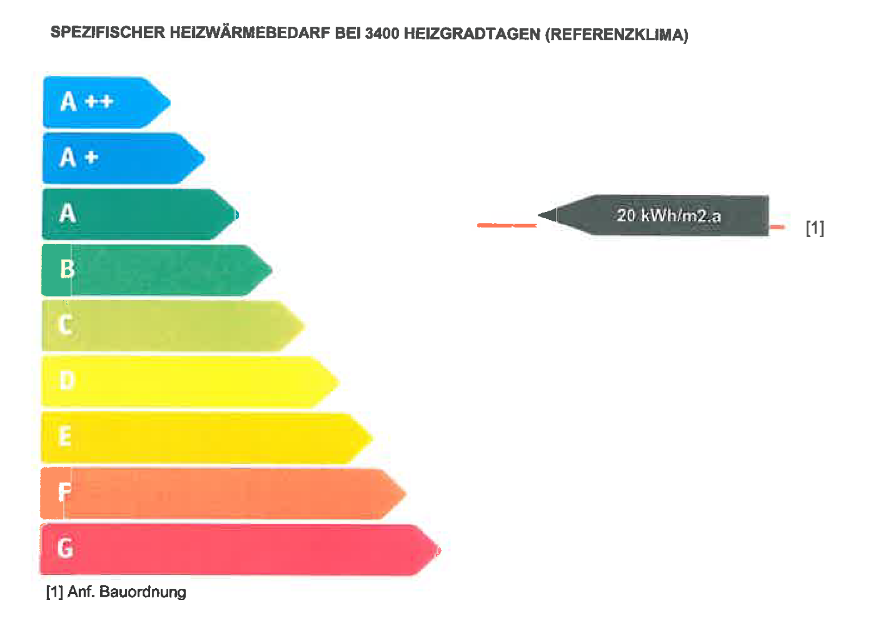
Stationary facilities
Example
Franziska-Fast-Haus
Wien, Gumpendorfer Gürtel
housing for homeless people
building year: 2010
living space: 2481 m², 86 apartments for 86 people
heating/hot water costs/m²a: EUR 40,01 (district heating)

Slide 5
Stationary facilities
Examples
Haus Liesing
Wien – 23nd district
housing for homeless people
building year: 2007
living space: 2095 m², 63 apartments for 65 people
heating/hot water costs/m²a: EUR 26,56 (district heating)
no energy certificate

Slide 6
Stationary facilities
Examples
PLS:
Wien-Donaustadt
housing for refugees – male only
building year: unknown – probably 1980s
living space: 1080 m², 37 apartments for 74 people
heating/hot water costs/m²a: EUR 17,84 (district heating)
no energy certificate

Slide 7
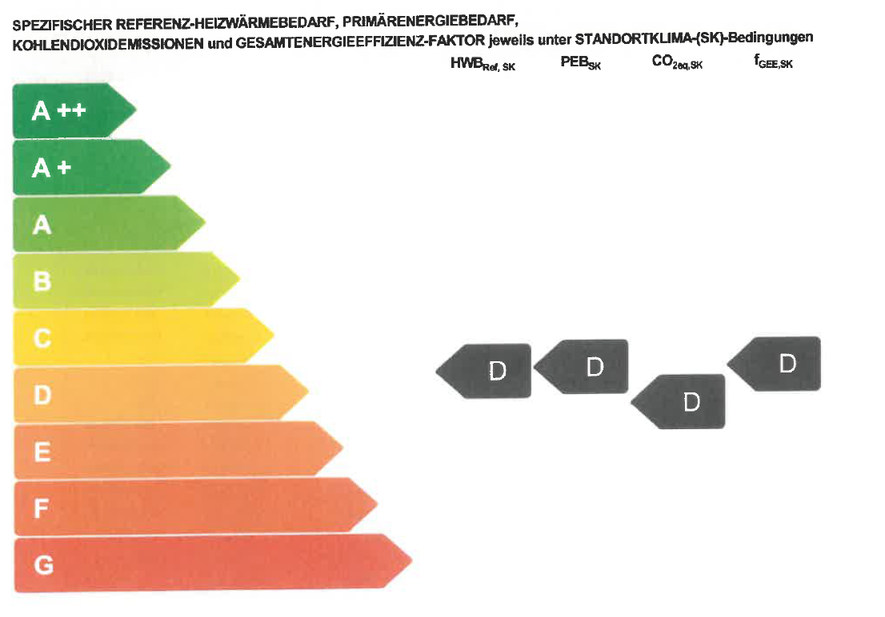
Stationary facilities
Examples
Bruno Kreisky-Haus
Wien-Floridsdorf
housing for refugees
building year: 1974
living space: 2478 m², 49 apartments for 180 people
heating/hot water costs/m²a: EUR 29,87 – oil-heating!

Slide 8
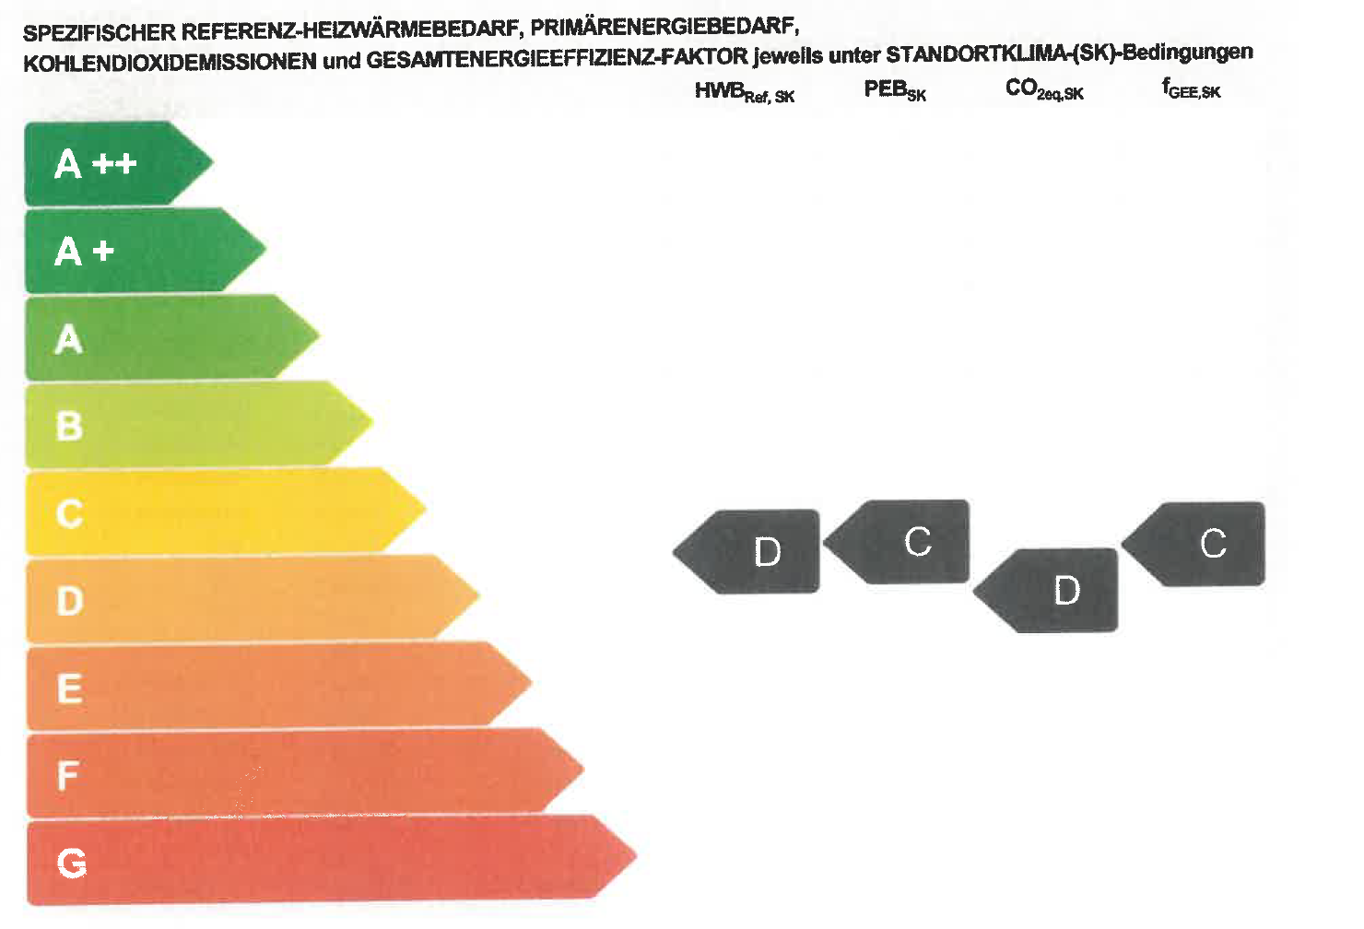
Stationary facilities
Examples
BKH-E:
Wien-Brigittenau
housing for refugees
building year: 1966
living space: 718 m², 25 apartments for 49 people
heating/hot water costs/m²a: around EUR 30,-

Slide 9
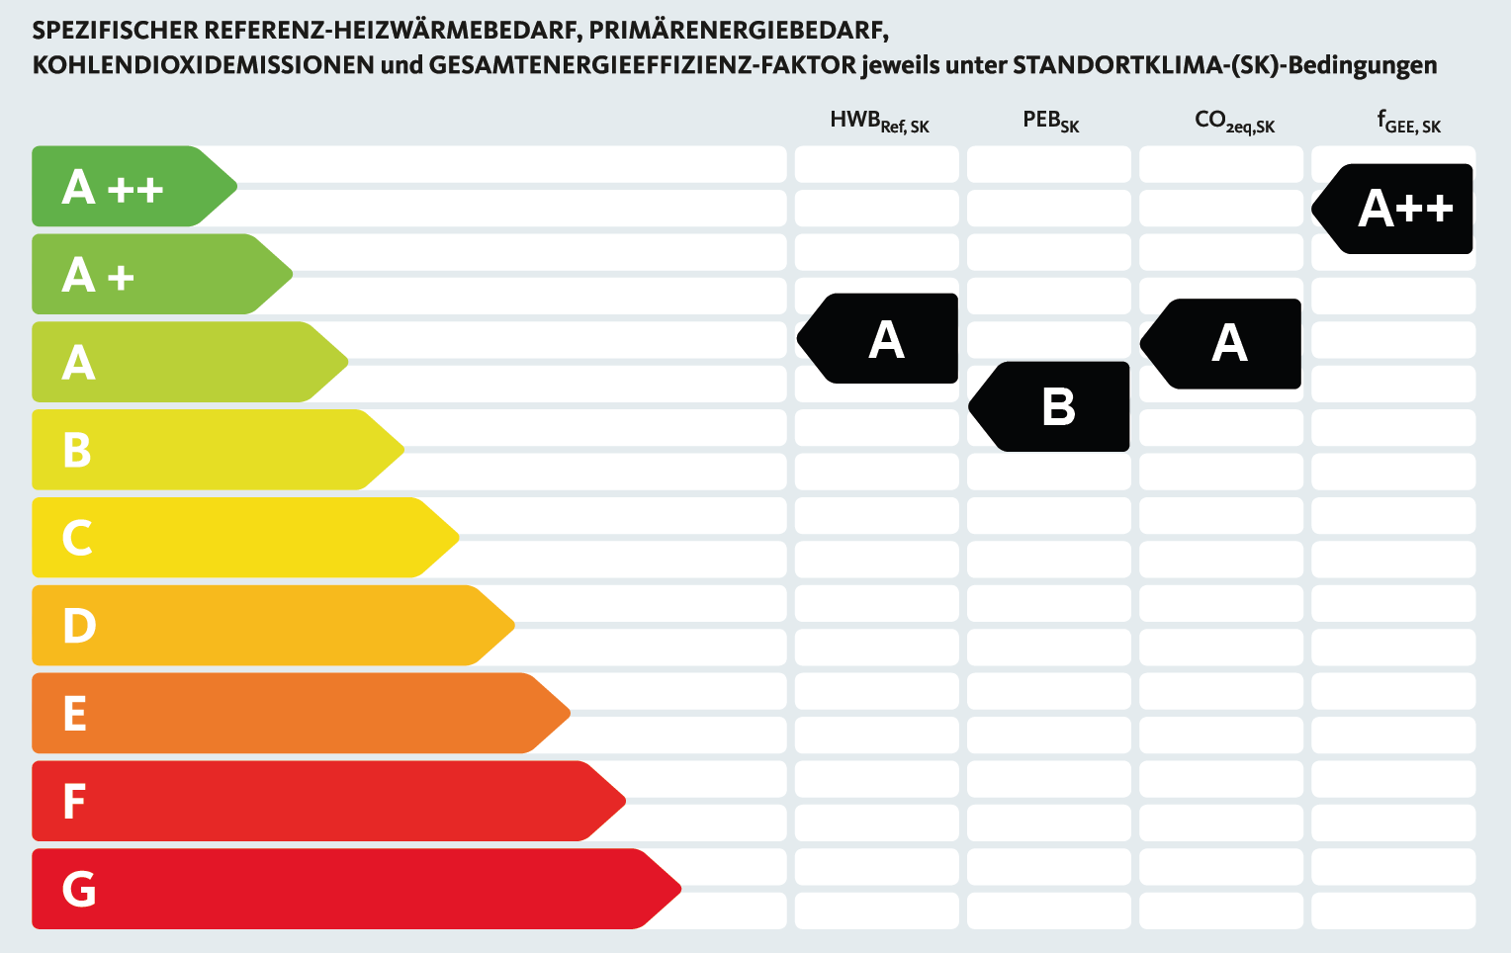
Stationary facilities
Examples
Hafen*:
Wien-Heiligenstadt
housing for women in difficult situations
building year: 2022
living space: 2377 m², 29 apartments, 1 shared accomodation unit, for 78 people
heating and hot water production through heat pump, electric energy partly through photovoltaics.
Enables us to provide fixed rent rates; high quality: thermal component activation, predicitve weather control
heating/hot water costs/m²a:
around EUR 18,- - electricity costs for heat
pump, own PV-production not deducted

Slide 10
Out of oil and gas
Subsidies
„Sanierungsbonus“ – improvement of thermal quality of the building
up to EUR 525/m²
„out of ail and gas-subsidies – change of heating system to district heating, heat pump, …
up to 75 % of investment
additional provincial subsidies

Slide 11
Legal situation
Greening the heating system
Volkshilfe Wien is tenant, not owner – not our decision!
Improvement to district heating can be enforced against the landlord under certain conditions
Other improvements cannot be enforced
→ higher expenses for us!

Slide 12
conclusion
Legal changes are necessary
Funding authorities should support organizations in switch to better buildings – cheaper in the long run
landlords must be forced to change to an ecological heating system
higher costs than necessary must be paid by the landlord

Slide 13
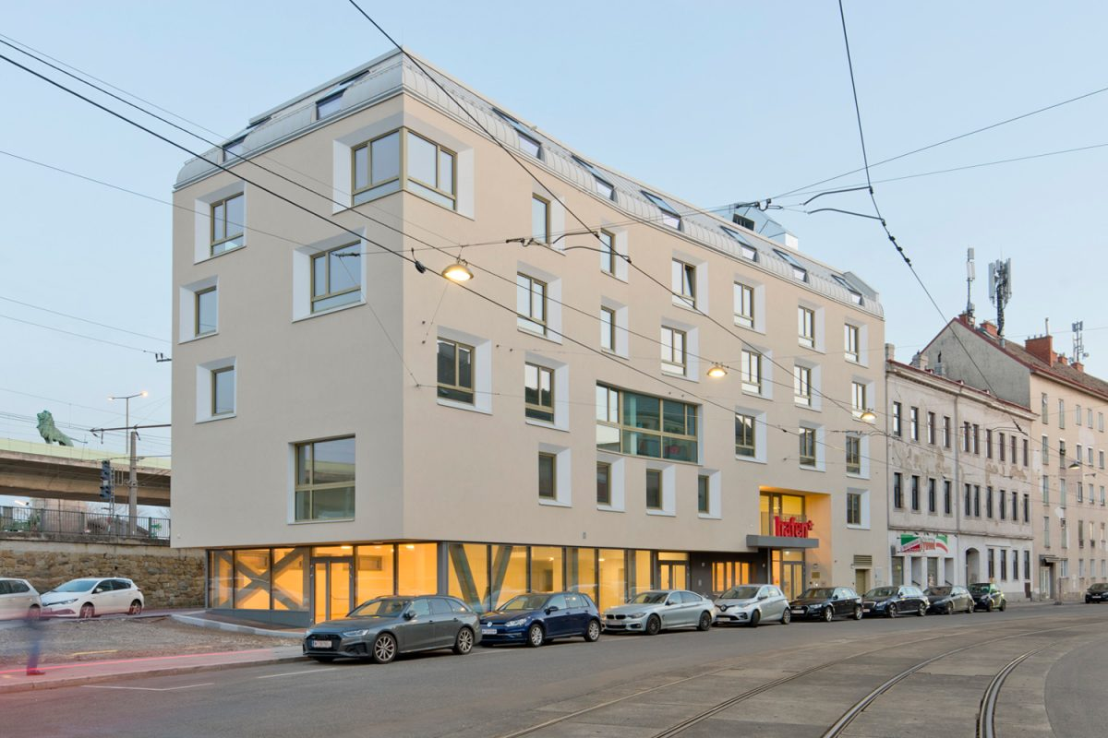
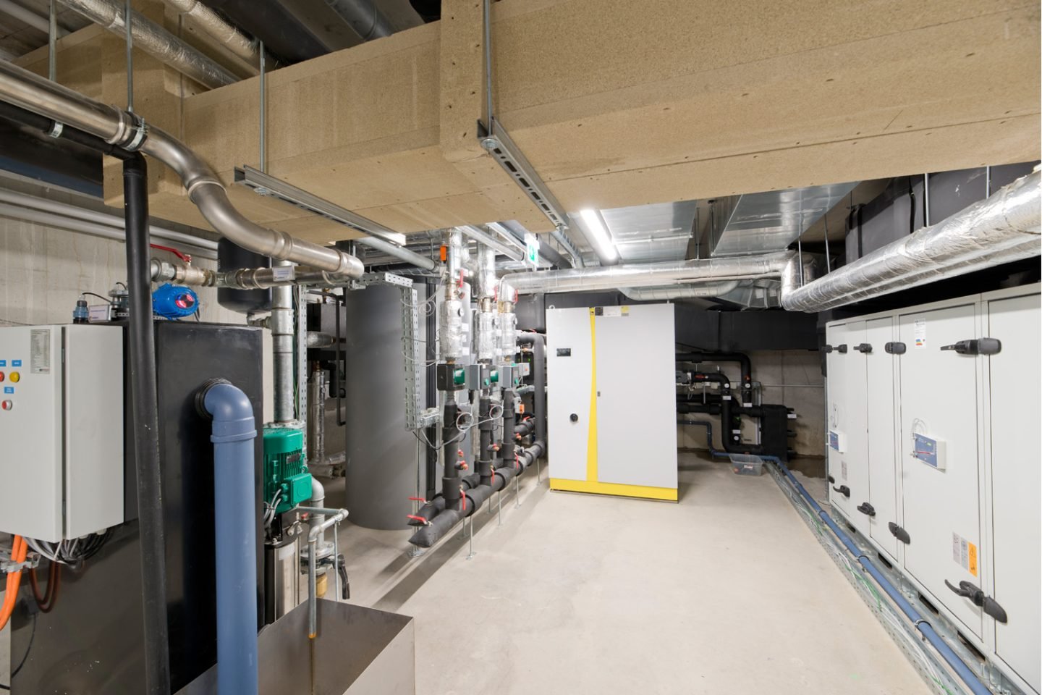

Slide 14
Mag. Martin Orner Head of REAL ESTATE & LAW VOLKSHILFE WIEN GEMEINNÜTZIGE BETRIEBS-GMBH Bloch-Bauer-Promenade 13/2B
1100 Wien Mobil: +43 676 8784 1767

